Slide 1
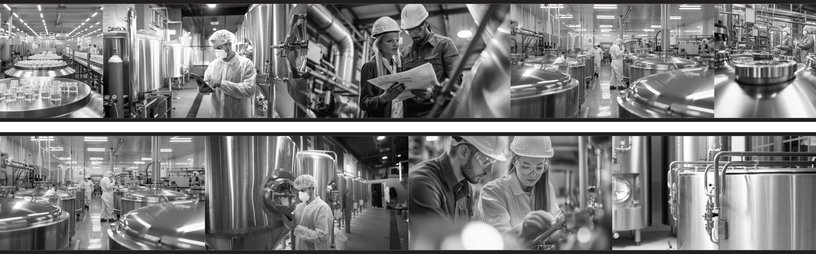
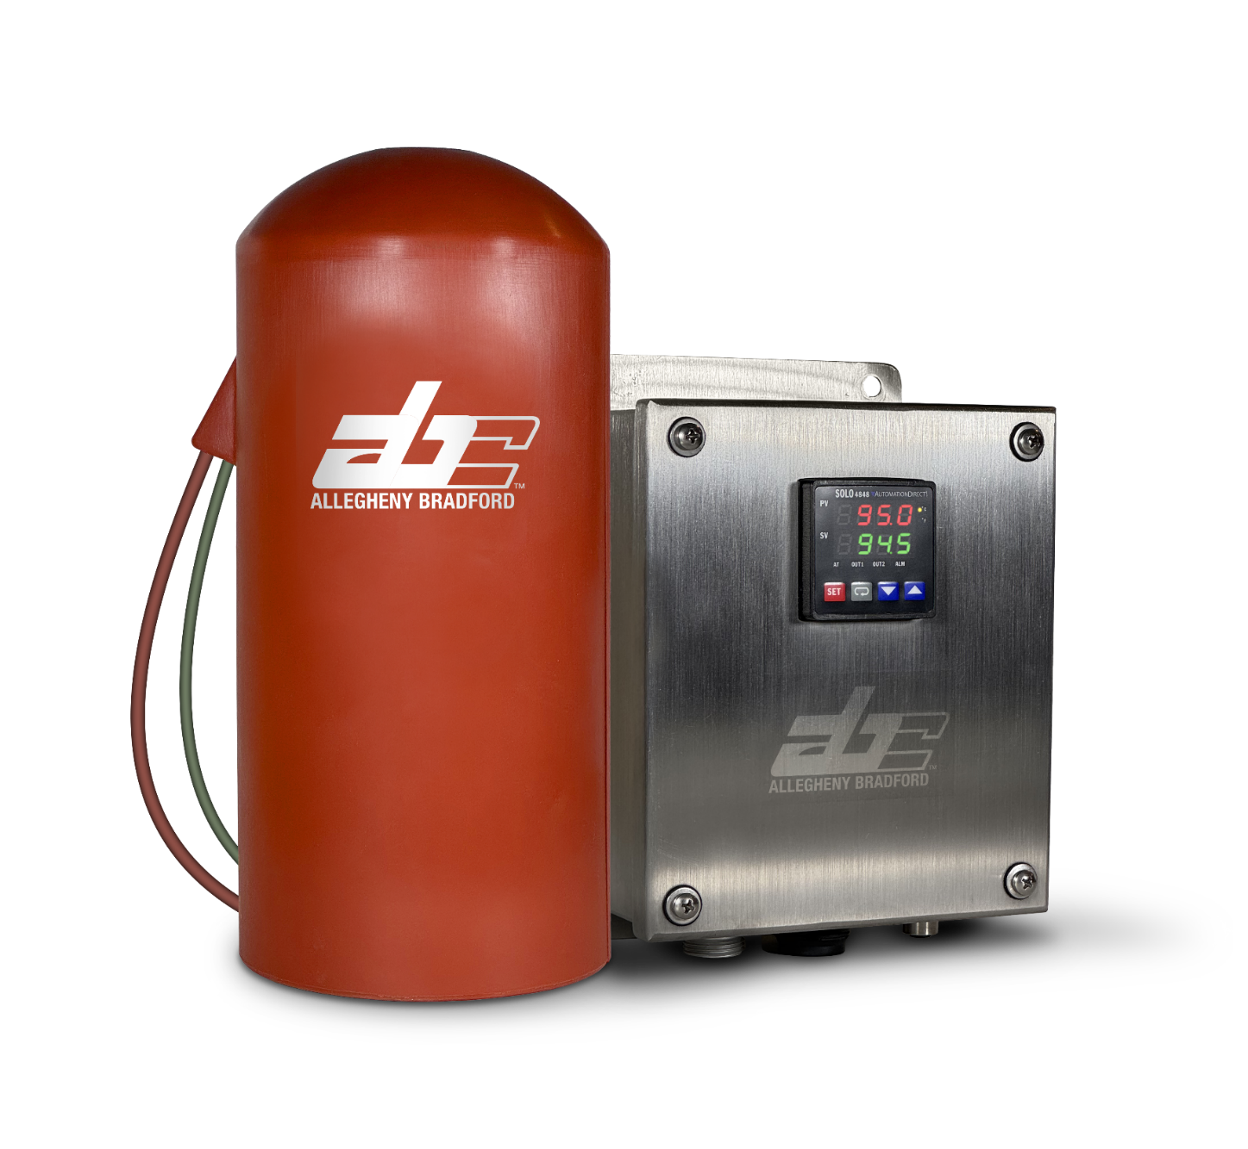


ThermaRed CPD™ Filter Housing Heater Jacket
ThermaRed CPD ™ Filter Housing Heater Jacket
CONSIDER IT DONE

Slide 2

WHY?
Bio burden
  Bio burden occurs when hydrophobic vent filters become “blinded” by moisture caused by condensation inside the filter housing.
  The combination of moisture, warmth, and darkness creates the perfect environment for microbial growth.
Sterility is lost – so is your batch.
CONSIDER IT DONE

Slide 3
WHY?
Bio burden
  Monitoring for early detection of microbial growth is extremely difficult and once it is discovered, it is likely too late to do anything about it.
Sterility is lost – so is your batch.
CONSIDER IT DONE

Slide 4
STEAM – WHY NOT?
Steam isn’t easily controlled or adjustable
Steam traps upstream from the vent filter inlet can fail, causing extremely high temperatures.
These high temperatures can deform and even melt the element inside the housing.
Sterility is lost – so is your batch.
CONSIDER IT DONE

Slide 5
INDUSTRY NEEDS
Current industry design calls for:
  An electrical heat jacket with controller offering three forms of control and alert.
  Steady temperature control.
  The ability to withstand rigorous removal and re-installation procedures, as well as exposure to chemical sanitization materials such as peracetic acid.
CONSIDER IT DONE

Slide 6
WAITING AND WAITING
Current industry pricing and turnaround
Current pricing levels for this product have nearly tripled over the past 16 months.
Standard lead times are anywhere from 18-36 weeks.
CONSIDER IT DONE

Slide 7
IT’S AS EASY AS ABC
Introducing the new ThermaRed CPD
Condensate prevention device available in under 8 weeks.
Available at a substantial savings.
CONSIDER IT DONE

Slide 8
IT’S AS EASY AS ABC
ThermaRed CPD is specifically designed to:
  Prevent vapor condensation in sterile vent and process filter applications.
  Maintain operating integrity of hydrophobic vent filter cartridges in 5”, 10”, 20”, and 30” sizes.
  Provide reliable functional and equivalent temperature control.
  Fully compliant with current safety standards and regulations, such as UL approval.
CONSIDER IT DONE

Slide 9
IT’S AS EASY AS ABC
Additional features of ThermaRed CPD
High/low temperature alerts, power switching for high limit.
Low temperature alarm to indicate a temperature change, power loss, or a similar outside influenced condition during a batch run.
CONSIDER IT DONE

Slide 10
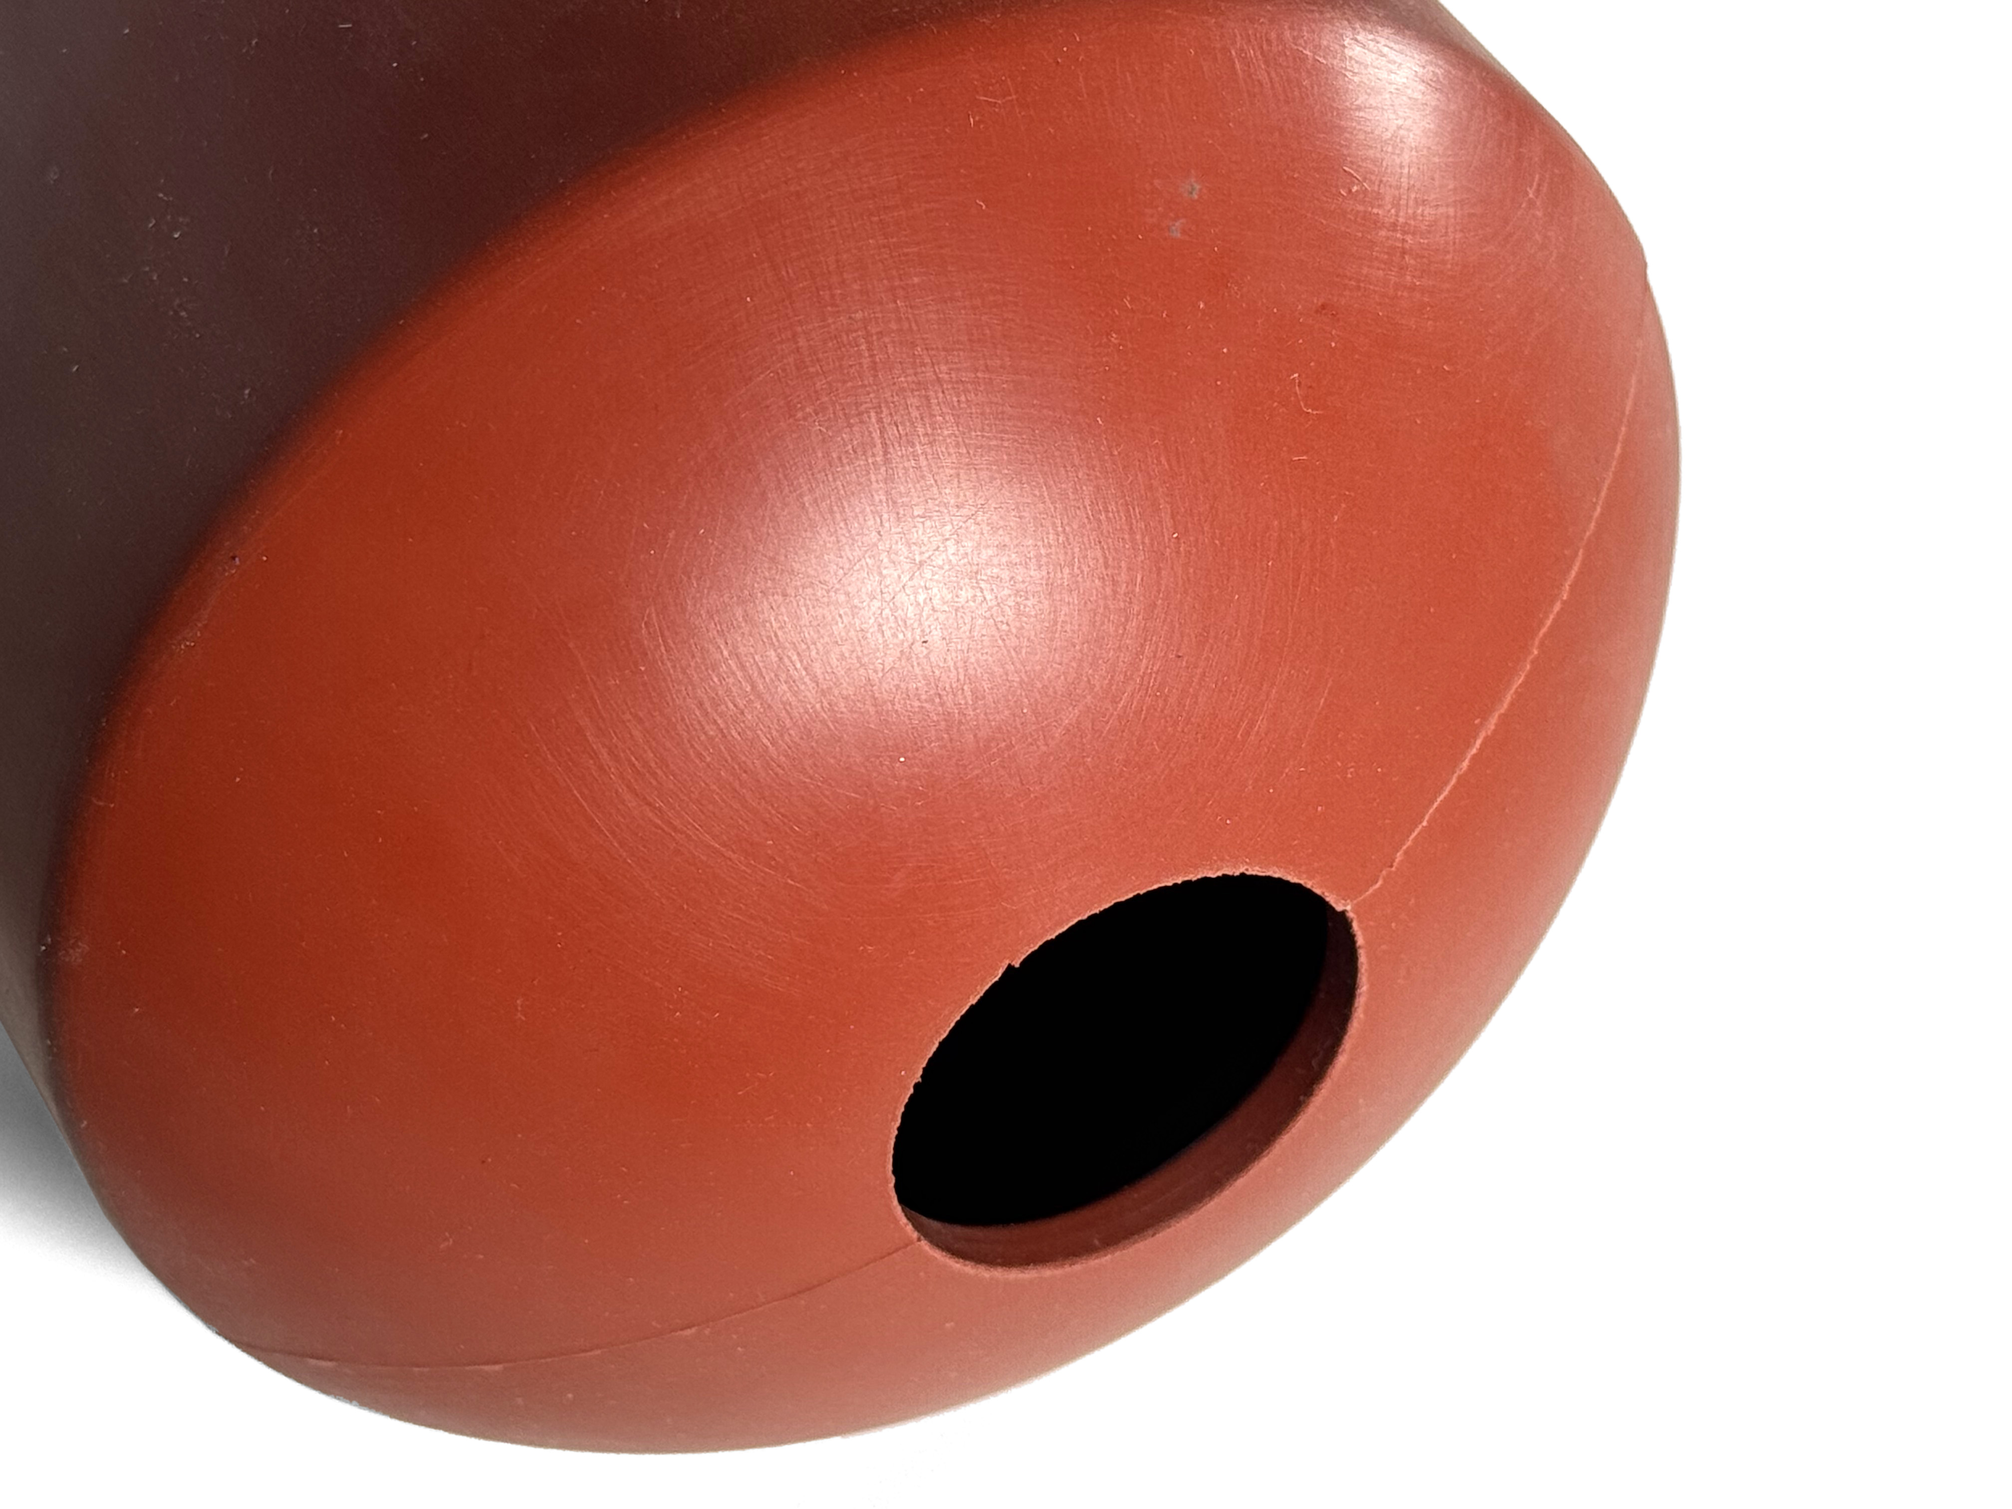
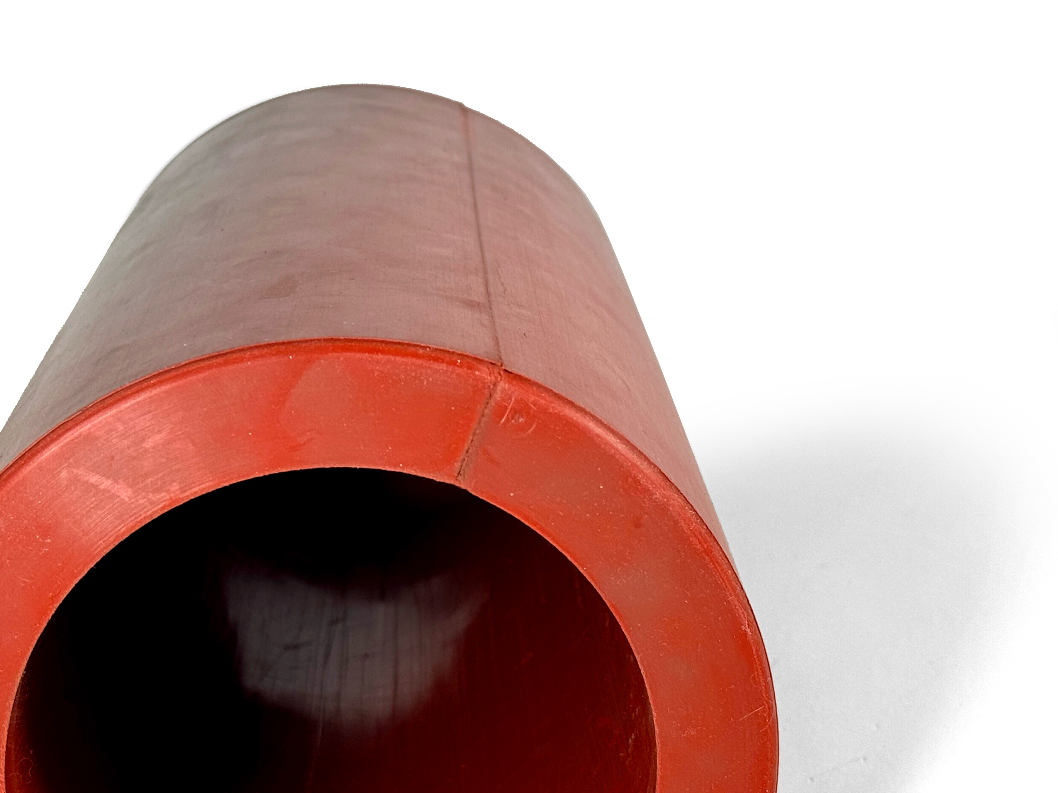
IT’S AS EASY AS ABC
Additional features of ThermaRed CPD
One-piece spring-loaded jacket fits tightly without flimsy straps or Velcro to maintain snug contact with filter housing shell.
CONSIDER IT DONE

Slide 11
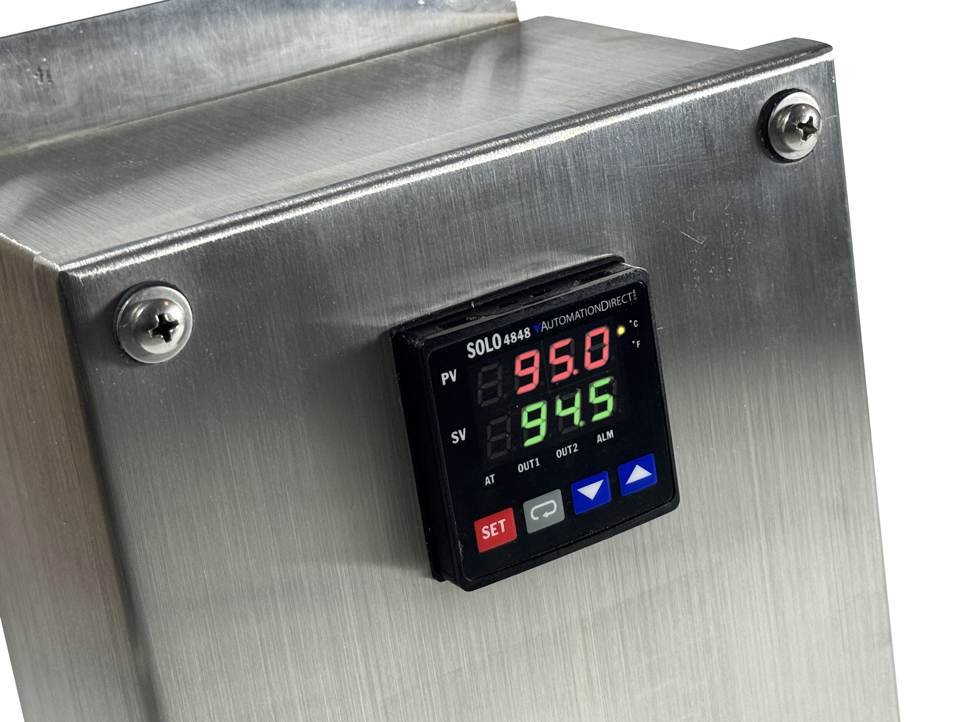
IT’S AS EASY AS ABC
Additional features of ThermaRed CPD
Rugged stainless steel control box with digital display and optional Modbus RTU Communication module.
Improved rugged design for cables and connections adding strength under the most difficult conditions.
CONSIDER IT DONE

Slide 12
TECHNICAL DATA
ThermaRed CPD specs
Material: Molded silicone and fiberglass-reinforced silicone foam
Filter Temperature: Adjustable 0-120 °C with controller
Heater Exterior Surface: Max. 60 °C
Cured Silicone Materials: Max 200 °C (392 °F)
Electrical Rating:
  120 V~, 50/60 Hz, max. 10 A
  240 V~, 50/60 Hz, max. 10 A
CONSIDER IT DONE

Slide 13


WANT TO LEARN MORE?
We’re here to talk
Pat Cunneen
Business Development Manager
814-558-3569
pcunneen@alleghenybradford.com
Tom Johnson
Regional Sales Manager - Northeast
814-558-3592
tjohnson@alleghenybradford.com
CONSIDER IT DONE

